Slide 1
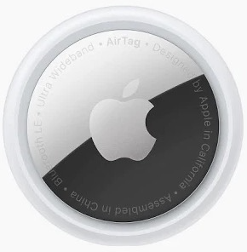





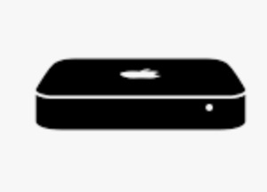

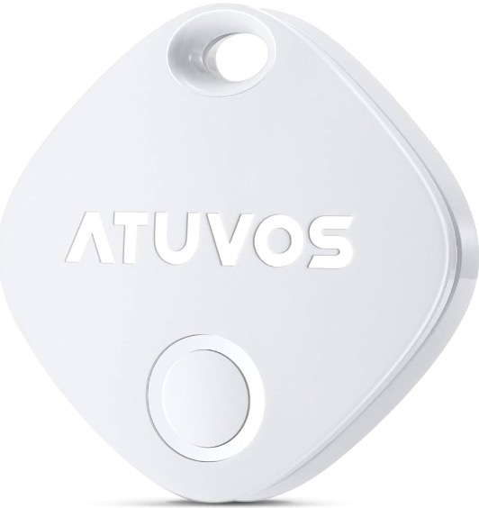
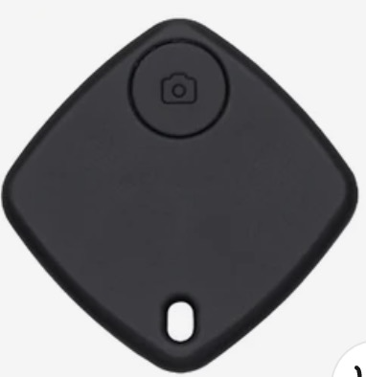



Welcome to Mr Tracker
The ultimate World Item Tracker
V1.2

Slide 2
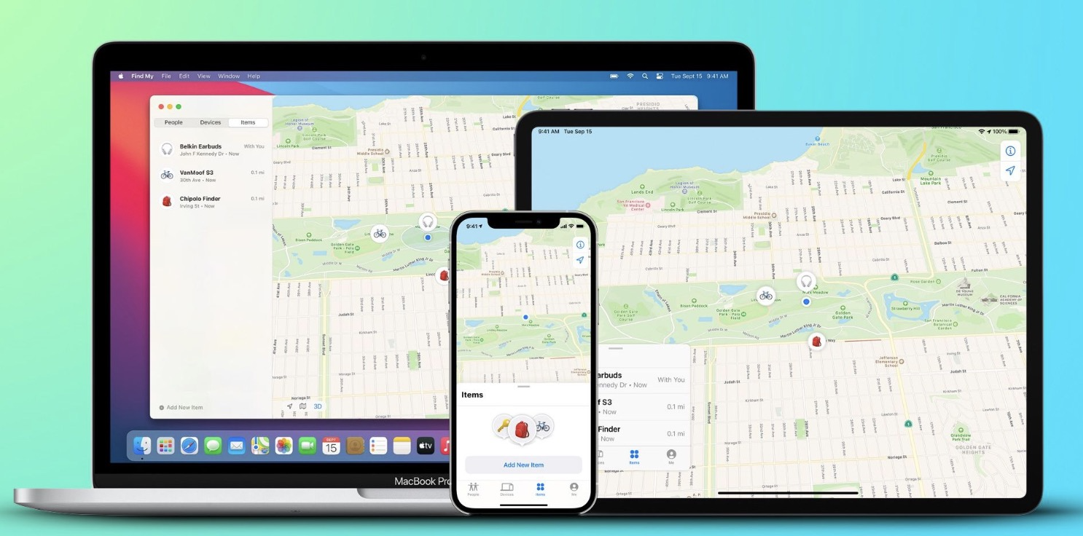
Airtags and third-party “knock-offs”
The history of Apple Airtag and other FindMy devices
AirTag is a super easy way to keep track of your stuff. Attach one to your keys, slip another in your backpack and just like that, they're on your radar in the Find My app, where you can also track down your Apple devices and keep up with friends and family. Apple Airtags were announced April 20, 2021 and Apple launched the Find My network accessory program designed for third-party accessory makers at the same time, allowing device makers to integrate Find My right into their products. Single Airtags cost about $40 CAD while third-party tags with similar operation have been sold for as low as $5 CAD. The main difference between the third-party and Apple’s creation is the use of a U1 chip where with Airtags you can locate the tag with a proximity guide. This same functionality can be had with a $3 bluetooth tracker so not having a U1 chip is not too critical to justify the extra cost of the Apple Airtag vs third-party.

Slide 3
Introducing Mr Tracker
Mr Tracker fills the gap of providing location history tracking
Apple will never provide the location history of where a tag has been, they only provide the last known location that a tag was identified at due to privacy concerns.
Wouldn’t it be nice if you could harvest all the location that the tags have been and not only that also visualize the routes on a world map? Well, welcome Mr Tracker who fills that gap. Mr Tracker intercepts the data that is fed to the FindMy app and stores it in a database for use in mapping out the coordinates for you to visualize the data. This is accomplished by using sophisticated scripting that pulls data from the FindMy cache and saves it for later use. Data is available for all Items and Devices on an icloud ID.
The solution is composed of a computer running MacOS that is logged in to the same icloud account as where the FindMy tags are registered to. This computer will run FindMy in the foreground and must be dedicated to just data harvesting. The data is then fed through use of an API to the Master web and API server which services the mobile and web clients.

Slide 4
MR🌐Tracker - The ultimate World Item Tracker
MR🌐Tracker Revolutionizes Item/Device Tracking
Keep close tabs on the current and past locations of your Items and Devices
All platform support: iOS & android mobile apps integrate with a backend server
Collects and manages location data from any FindMy item or Device
3 ways to get on-board and start using Mr Tracker
Rest API - client runs a MacOS computer and harvests their own location data
Shared tags - client shares tags with our Feeder system
We send you a registered tag optionally shared with your iphone
We send you a registered tag - no sharing, android

Slide 5







The MR🌐Tracker Ecosystem
The ultimate side hustle
https://MrRobby.ca
C
L
I
E
N
T
S
D
E
V
I
C
E
S
/
I
T
E
M
S
API Remote
Feeders
32 tags each
Master
Django
server
Register tags via iphone
ssh
Feeders
32 tags each

Slide 6
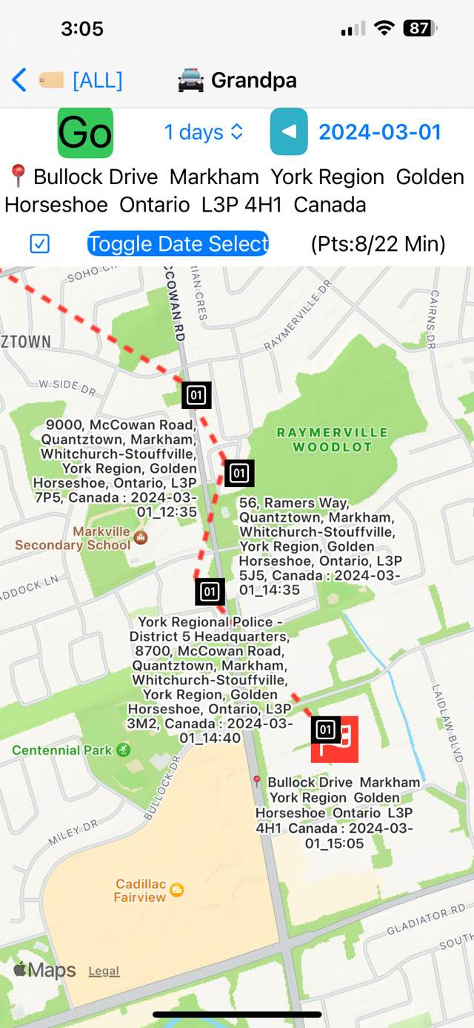
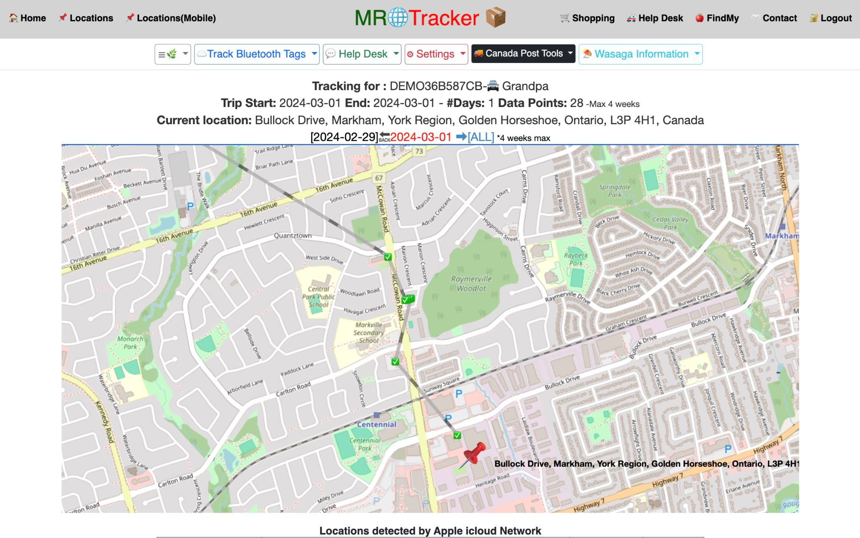
Mobile & Web Access to Mr Tracker
Seamless integration to the Solution

Slide 7
The #1 question, how do I use my tags with MR🌐Tracker
There are several ways that your FindMy tags can be added to Mr Tracker.
Purchase FindMy tags from Mr Tracker and subscribe and we will send you your tags in the mail. Perfect option if you do not have an iphone.
Purchase FindMy tags from Mr Tracker and subscribe and we will send you your tags in the mail and also share the tag with your iphone
Share your FindMy tags with Mr Tracker if you already have tags
Run your own MacOS computer(feeder) at your site and use our API to send the data for all your FindMy tags to our Master server and scale with business growth by adding additional feeder servers as needed
Become a Franchisee and use your extra MacOS capacity to run a business and also service your own business needs, make money using Mr Tracker!

Slide 8
Franchising Opportunity: Apple Technology Passion
Innovative Subscription-Based Service with you being the Franchise owner
Utilizes Bluetooth tracking tags.
Mac computers establish a supporting network.
Each Mac computer supports up to 32 tags
Used Mac computers range $250-$350 each
Tags integrate seamlessly with Apple's iCloud network.
Compatible with popular devices like Airtags, eufy SmartTrack tags, Atuvos, iTag, etc.
Straightforward Pricing Model
Customer to pay a $6 per tag per month subscription fee for the service
You as Franchisee provide customer support and back-end services
Scalable to unlimited subscribers
Turnkey solution once initial setup is completed, let the cash flow in!

Slide 9
The Franchise- The Ultimate Side Hustle - $100k+/year
$$ Revenue Potential $$
Subscription revenue: $2,304 per year per set of 32 tags at $6/tag/m subscription
Example: Managing 1,600 tags with 50 computers yields first-year revenue of $115,200, with huge growth potential
Franchise License
Nominal fee of $1 per tag/month to the franchise, payable for 1 yr term.
Covers cloud server operation and support services.
Guided setup process typically takes under an hour per server.
Essential Requirements
Reliable internet connection.
Effective customer acquisition strategies for subscriber base growth.
Sufficient Back-end servers in place
Platform Support
Native iOS App
Native Android App
All web browsers on MacOS, Windows etc

Slide 10
Franchising Offer and Details
Franchisable opportunity tailored for individuals with a passion for Apple technology, including Mac computers and iPhones.
Our innovative concept revolves around a subscription-based service for Bluetooth tracking tags. As a franchisee, you will establish a network of Mac computers dedicated to supporting these tags, with each server capable of accommodating up to 32 tags. These tags seamlessly integrate with Apple's iCloud network, including popular devices like Airtags, eufy SmartTrack tags, Atuvos, iTag, and more, readily available through platforms like Amazon.
Operating on a straightforward pricing model of $6 per tag per month to your subscribers, your primary concern will be configuring the FindMy tool and a set of accompanying scripts on each Mac computer. This setup, once established, functions as a turnkey solution. Each Mac computer supports up to 32 tags, requiring only an iPhone for tag registration onto iCloud.
Subscription revenue of $2,304 per year per set of 32 tags can be achieved. For instance, running 50 computers translates to managing 1,600 tags, resulting in a substantial first-year revenue of $115,200 ($6 per tag per month, multiplied by 1,600 tags, and then by 12 months).
To secure the franchise license, we request a nominal fee of $1 per tag/month, which is only 16.7% of revenue, , covering the operation of cloud servers and comprehensive support services. Our team will guide you through the server setup process, a task typically completed in under an hour per server once you get familiar with the process..
Please note, a reliable internet connection is essential for franchise operation, alongside effective customer acquisition strategies to bolster your subscriber base. The scalability of your earnings directly correlates with the expansion of your subscription clientele.

Slide 11
How to get started with your new Franchise
Requirements
Ensure your mac is running MacOS minimum version 11.5 and maximum 14.3.1
Ensure you have python3 installed with command “which python3”
Make note of the PATH where your python3 is installed
Install support modules:
pip3 install urllib3==1.26.15
pip3 install requests
Download script from github:
https://github.com/wilkyconsultants/mrtracker/blob/main/client_transfer.py
Change permissions to 775: chmod 775 client_transfer.py
Change top of script to include your python3 PATH:
# example:
#!/usr/bin/python3
Test the collector:
./client_transfer.py
Report any any errors from the client transfer script to Rob

Slide 12
Mobile phone client demonstration
The following demonstration shows typical operation of the iphone iOS client for Mr Tracker. Android will have similar operation.
iOS app link from your iphone:
https://apps.apple.com/us/app/mrtracker/id6476896068
To login to see demo airtags :
username: demo
Password: not required
Server: not required

Slide 13
Web client demonstration
The following demonstration shows typical operation of the Web client for Mr Tracker.
Visit : https://MrRobby.ca and click on demo link

